Slide 1
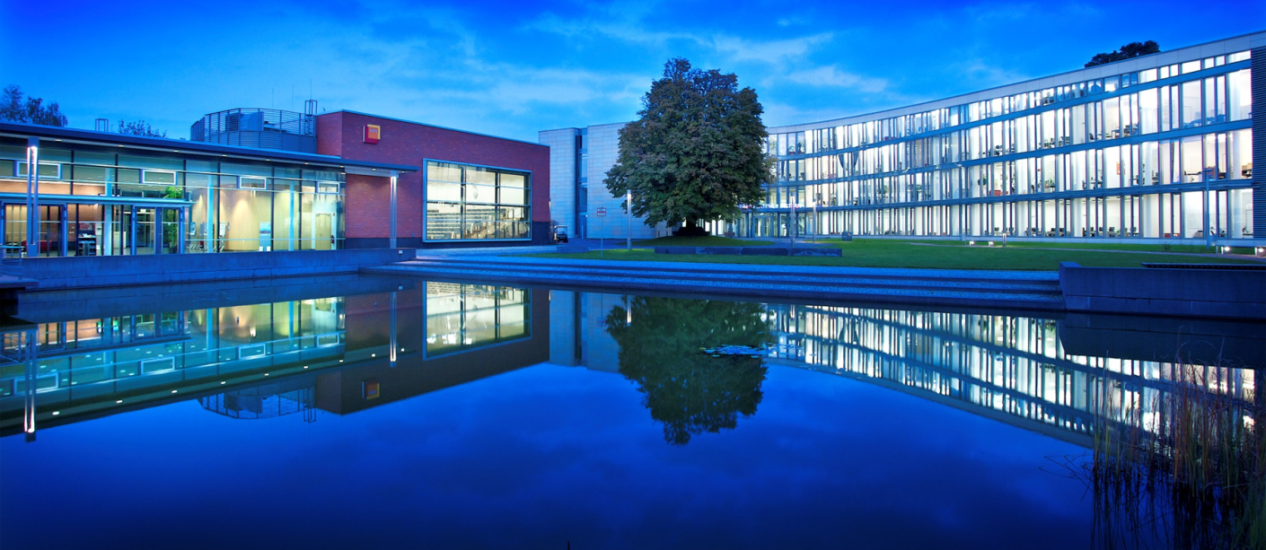
Presentation Title (Verdana 20pt) - maximum 2 lines
Johannes Eschrig, Sven Knebel, Nicco Kunzmann
MP P1 2015
Hasso-Plattner-Institut Potsdam

